Slide 1
Video calling web application using web RTC: “GLOBAL MEET ”
Hello
MCA GUYS !
MADE BY
Minakshi Kumari -49
Nandni -55
Himani-32

Slide 2
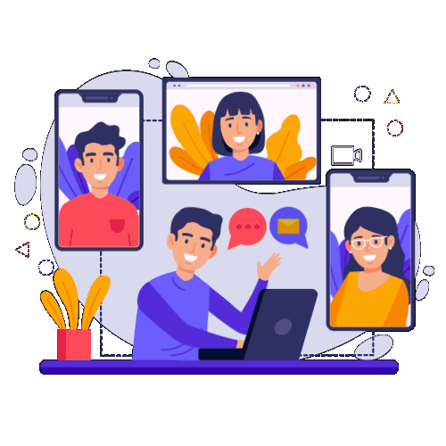
Introduction o n web RTC
Really great!

Slide 3
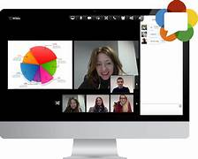
INTRODUCTION
WebRTC Technology
WebRTC is an industry and standards effort to put real- time communications capabilities into all browsers and make these capabilities accessible to web developers via standard [HTML5] tags and JavaScript APIs (Application Programming Interfaces).
The underlying standards of WebRTC are being developed by the World Wide Web Consortium (W3C) and the Internet Engineering Task Force (IETF)
- Current WebRTC initiative is supported by Google, Mozilla and Opera.

Slide 4
Real-time communications capabilities into browsers.
Accessible using HTML5 and JavaScript APIS.
Interaction between browsers.
Peer-to-peer Connection model.
No plugins required.
Transport: HTTP over TCP.
Hi!

Slide 5
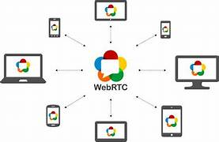
01
About the
Hello!
Web RTC Model

Slide 6
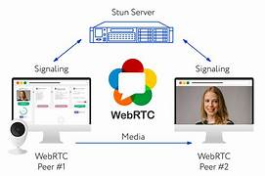
Web RTC Model Components
The functioning of WEBRTC can be divided into three components:
MediaStream: The first step is to have the data that the user want to share
In this case, the stream that user want (audio/video), the mode of communication to establish is captured.
Local media stream grants the browser to have access to stream devices such as the camera, web microphone
It also allows the browser to capture media. A user can make use of getUserMedia() function to get the access from the browser.
RTCPeerConnection: Once the user has decided stream of communication then the next step is to connect it with the partner’s system.
It allows the It allows your browser to exchange data directly with partner browsers (peers) for voice and video calls.
association between the sender and the receiver through STUN and TURN servers.
RTCDataChannel: It grants the browsers to exchange data bidirectional peer-to-peer.
CreateDataChannel() function is called for the first time on an instantiated PeerConnection object.

Slide 7
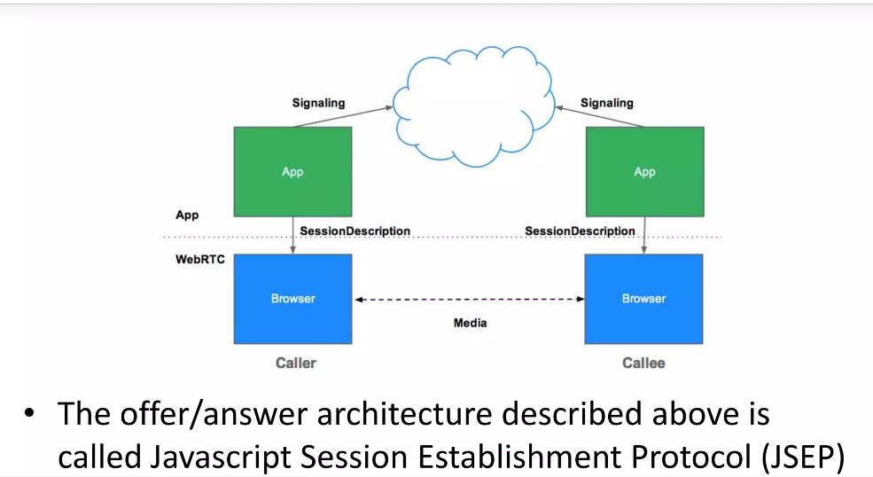

Slide 8
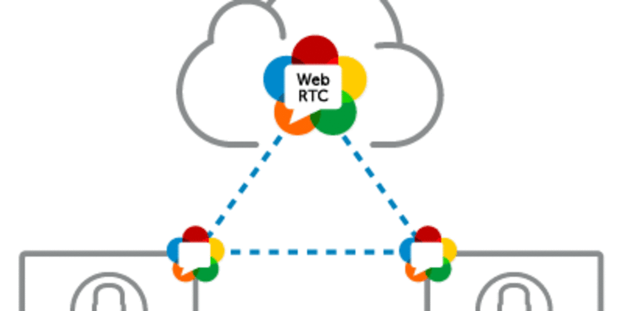
THE Web RTC Triangle
WEBRTC contains three different layers of API for web developers
The first layer contains all the APIs web developer demands, including RTCPeerConnection, RTCDataChannel, and media stream objects and their functions.
Second is the API for browser makers.
The third is the Overridable API, which browser makers can hook.

Slide 9
Proposed Technology Used
The proposed system provides user friendly interface and also provides powerful and efficient database management system.
The aim of proposed system is to develop a system of improved facilities. The existing system work is done manually thus hampering its accuracy and effectiveness. The proposed system can overcome the limitations of the existing system.
The system provides proper security and reduces the manual work.
The proposed system will help the user to reduce the workload and mental conflict. Through this system it is possible to print various reports and bills for the organization.
Great!

Slide 10
The Aim of the proposed system
It main Aim to develop a system of improved facilities
Security of data.
Ensure data accuracy.
Proposed control of the Higher Authority.
Minimum time needed for the various processing.
Greater efficiency.

Slide 11
HARDWARE AND SOFTWARE REQUIREMENT
Hardware Specification
Software Specification
Processor : Intel Dual based System
Processor speed: 2Ghz
Hard Disk : 8 GB
Keyboard : 104 keys
Technology Implemented: Web Development
Language Used: HTML, CSS, JavaScript
Web Browser: Google Chrome
Code editor: Windows Visual Studio code

Slide 12
About Global Village Web Application
In this we will build a web-based Video Calling application using HTML, CSS, JavaScript, Node.js, Express.js.
It is Social Networking digital communication web application that provides video chat between computers, tablets and mobile devices through web browser.
HTML describes the structure of a Web page. CSS describes how HTML elements are to be displayed on screen, paper, or in other media. JavaScript is used mainly for enhancing the interaction of a user with the webpage.

Slide 13
Node.js is primarily used for non-blocking, event-driven servers, due to its single-threaded nature.
This project is to create a application with a server and client that enables video conferencing and texting in Realtime.
Our project is an example of a client server application.
It is a real-time and multi-platform application and can be used by many users.
It provides video telephony and online chat service through a peer to peer service platform and it uses tele-conferencing and tele-commuting.
It is made up of 2 applications the client application, which runs on the users’ Pc and server application, which runs on any pc on the network.
To start Video chatting client should get connected to the server.

Slide 14
OBJECTIVES
This project is a real-time web application with very simple UI.
Users can video chat or send and receive text in Realtime.
To generate an IP Address for multiple users to connect to the same chat room.

Slide 15
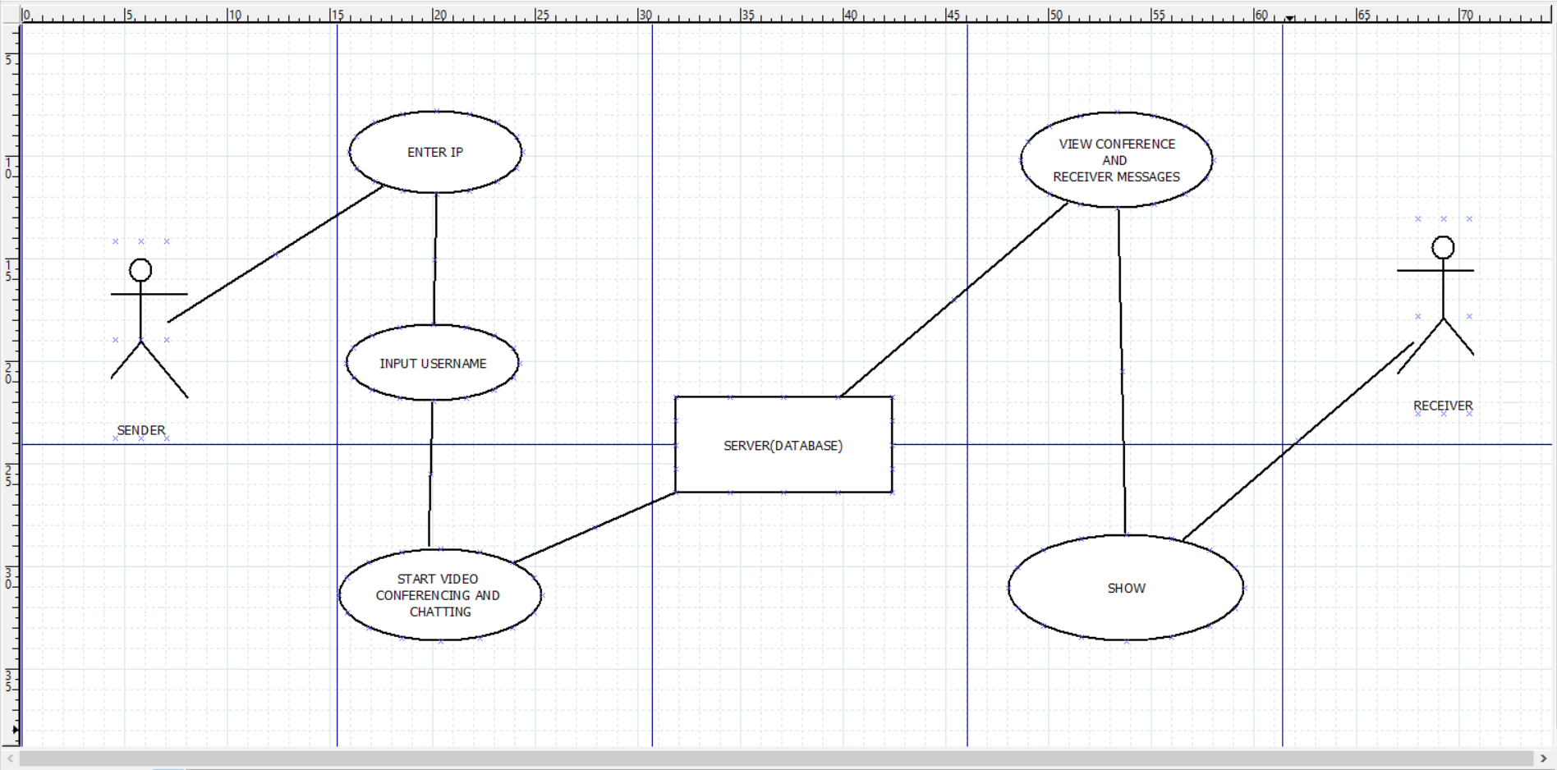
Implementation Details
First, we will work on making design for our website using pencil wireframe.
- Next, we will Initialize our Project.
- Then we will Initialize our first view Using HTML.
- After initializing first view we will create a Room ID.
- Then we will add the ability to view our own video.
- Soon after above we will add ability to allow others
to stream their video.
- Then we will add Styling Using CSS.
- After adding Styling, we will add the ability to create messages.
- Followed by adding mute button.
- Then at last we will add Stop Video Button too.

Slide 16
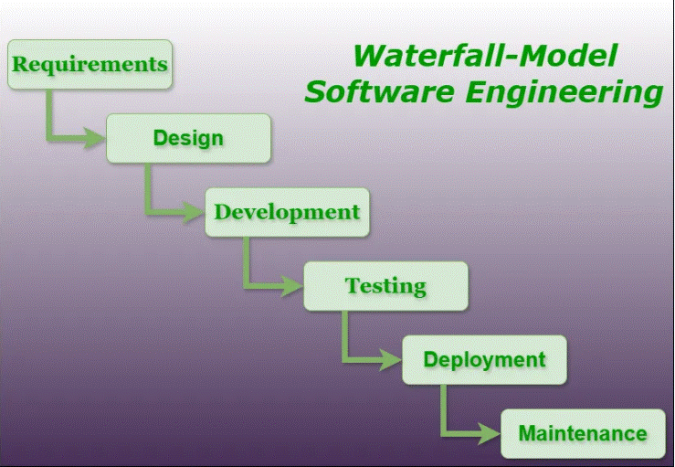
MODEL USED
The waterfall model is a software development model used in the context of large, complex projects, typically in the field of information technology. It is characterized by a structured, sequential approach to project management and software development.
Very nice!

Slide 17
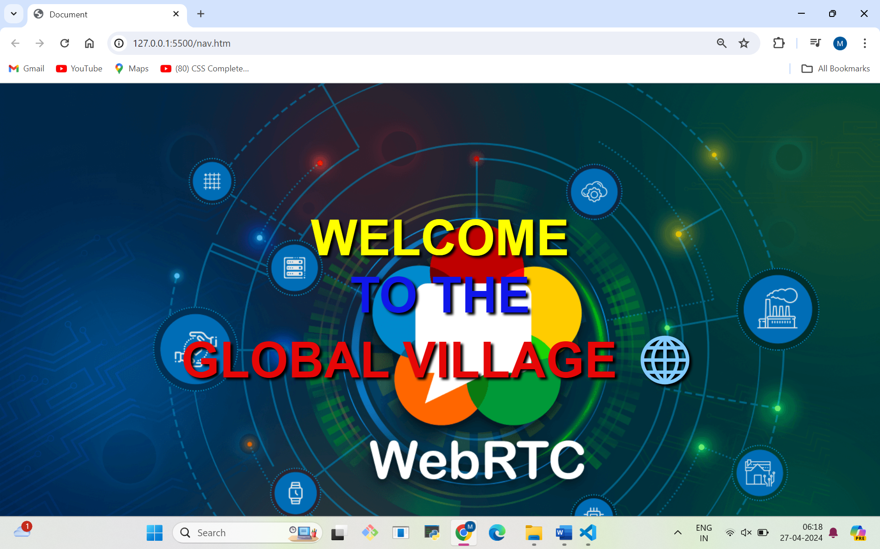

Slide 18
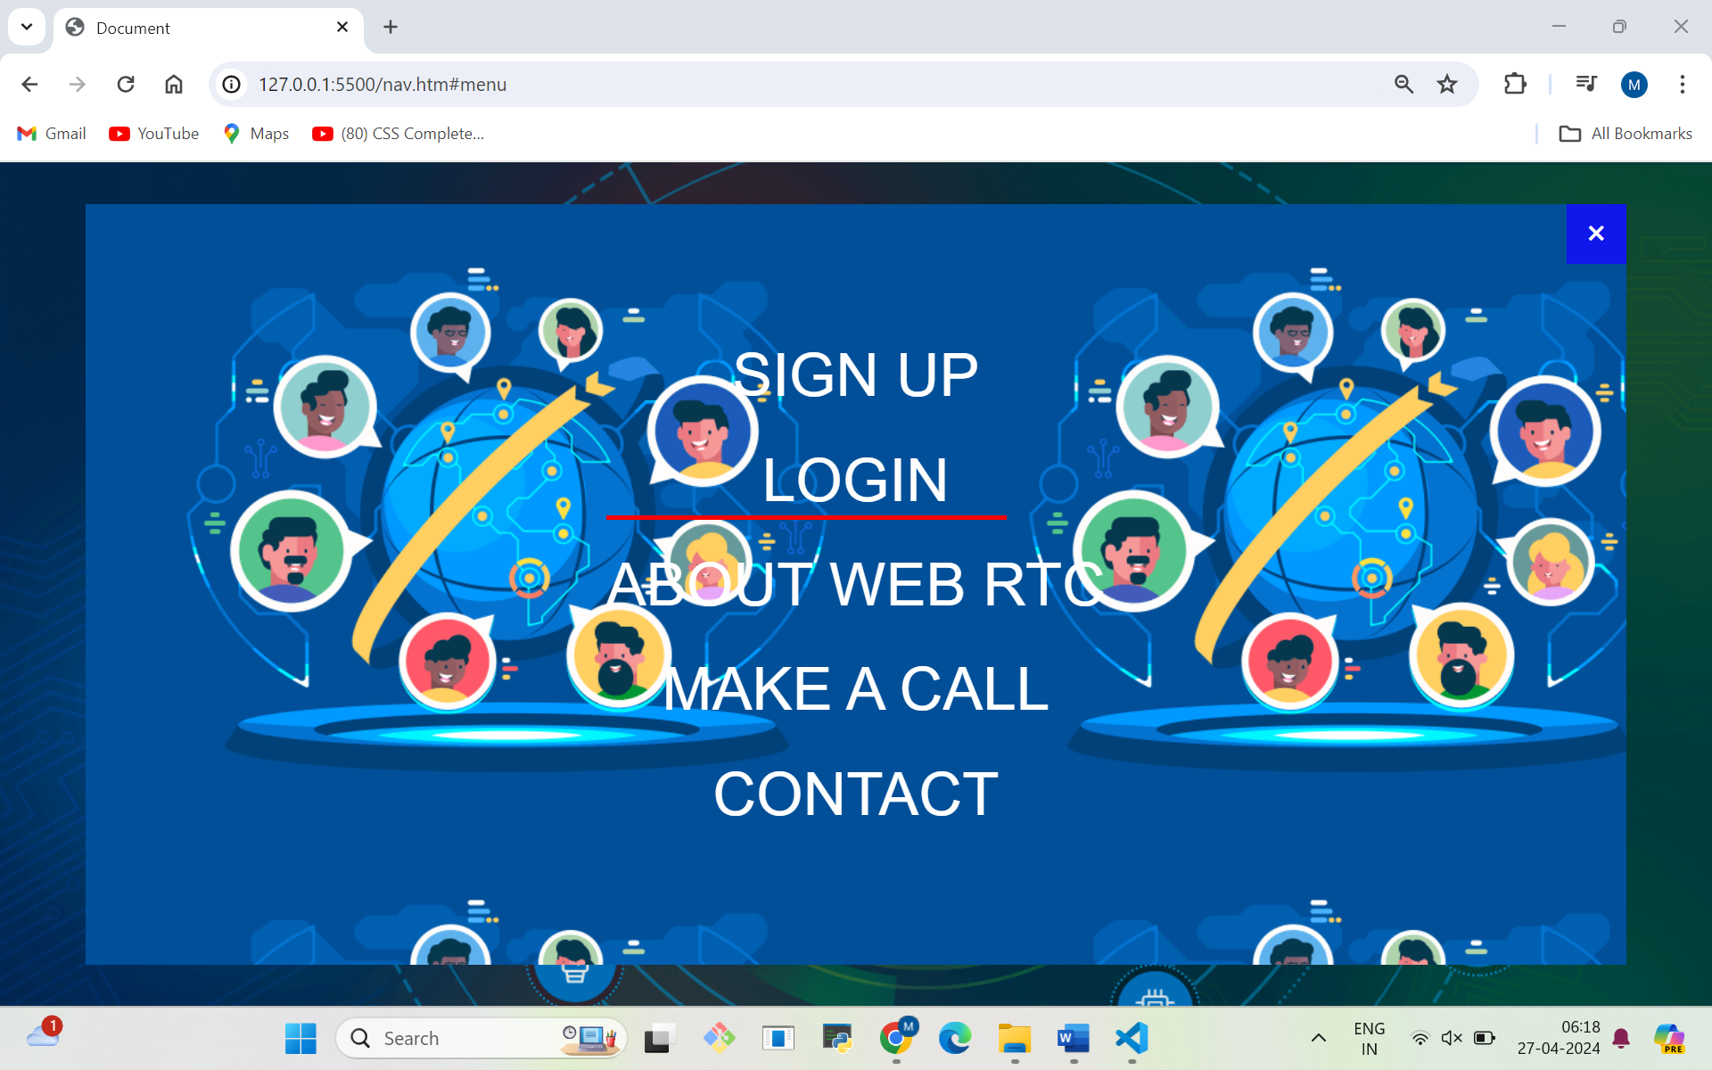

Slide 19
FEATURES AND MODULES OF GLOBAL VILLAGE
1. Sign up(Registration)
Registration is a key feature of an app. It allows users to create a profile which increases retention. However, most video chat apps make registration optional to simplify the process of using the application. You can enter your details like name ,email password ,date of birth to create own profiles.
,

Slide 20
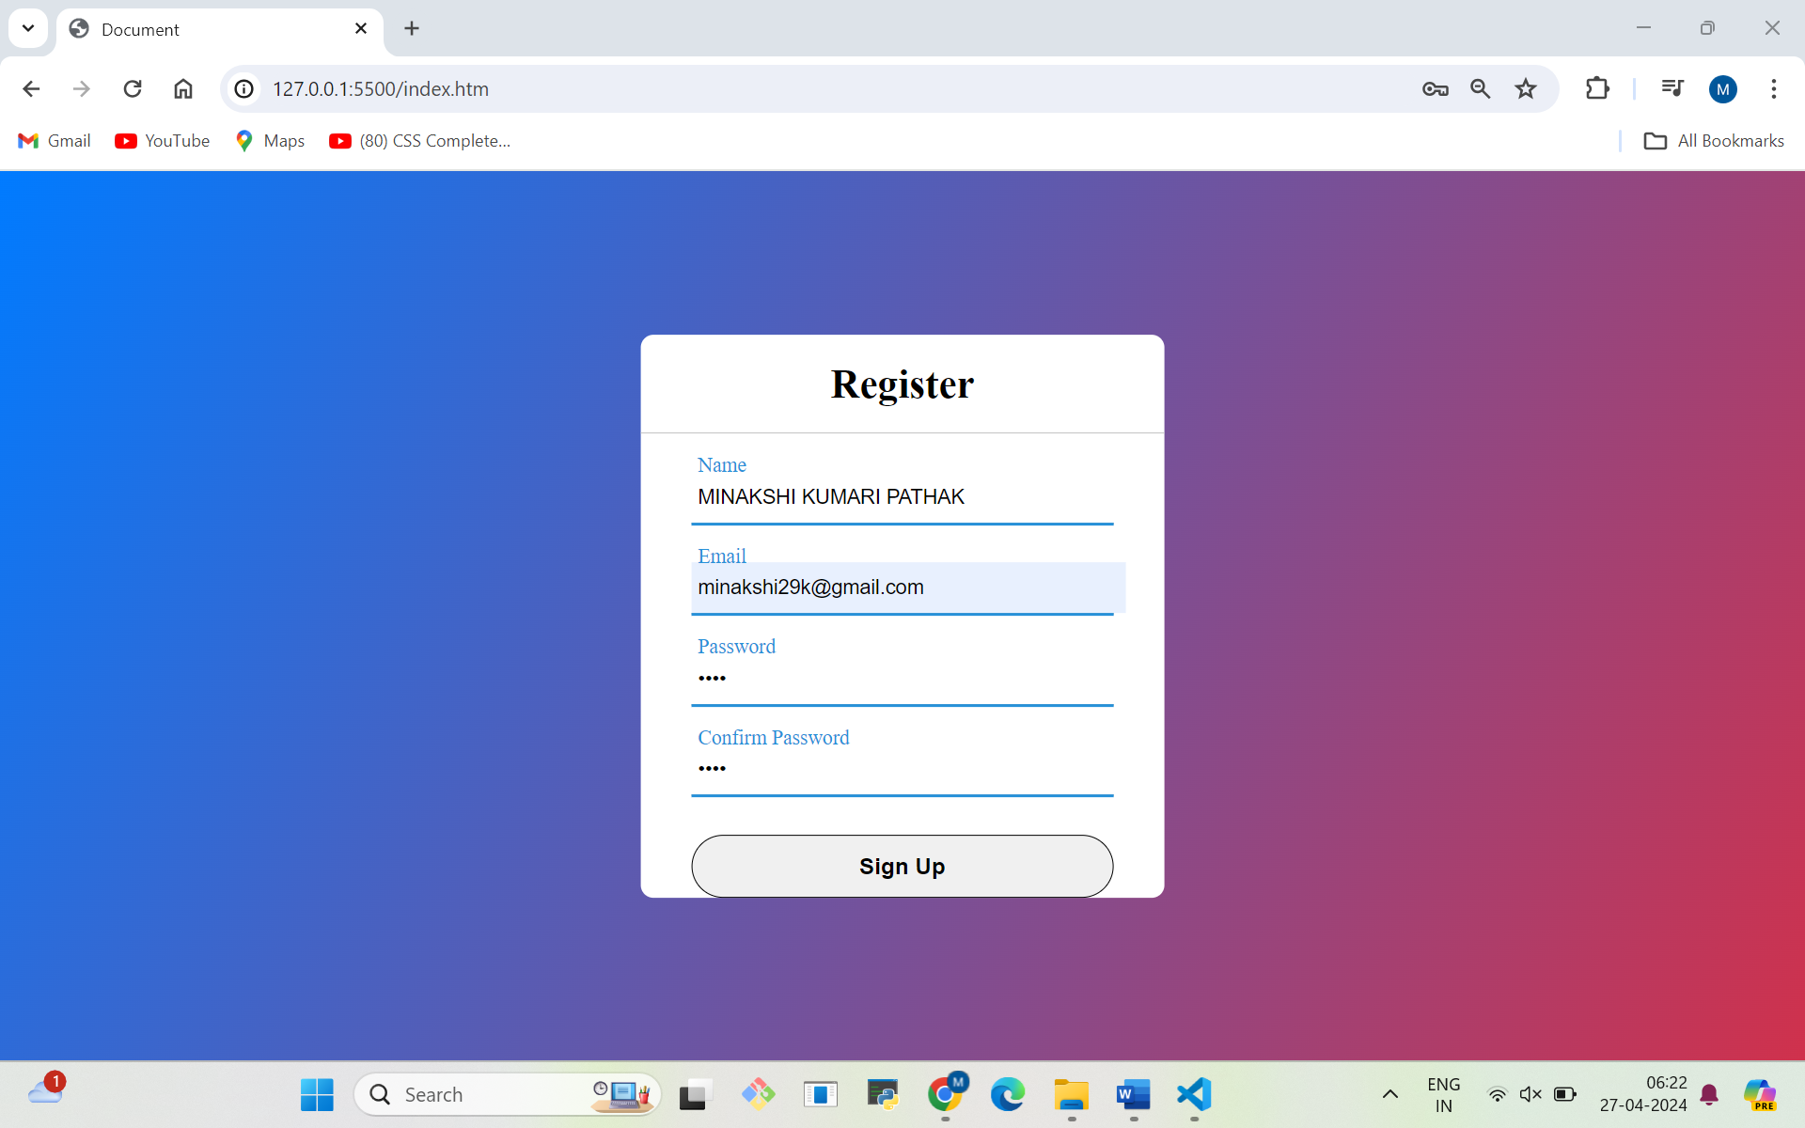

Slide 21
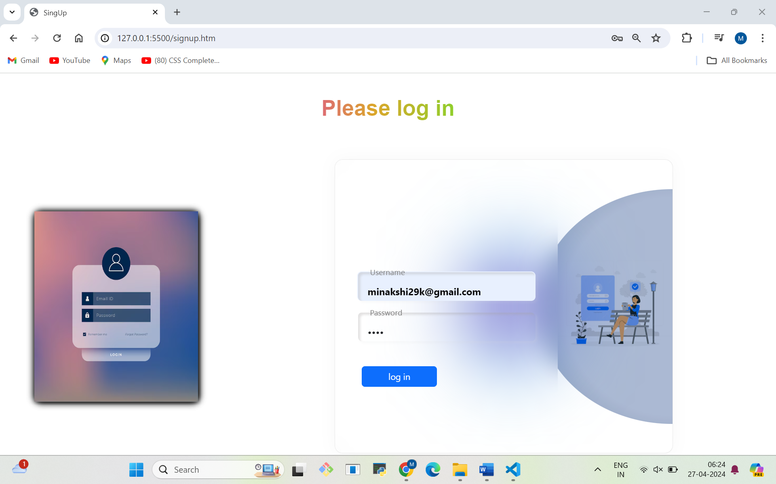
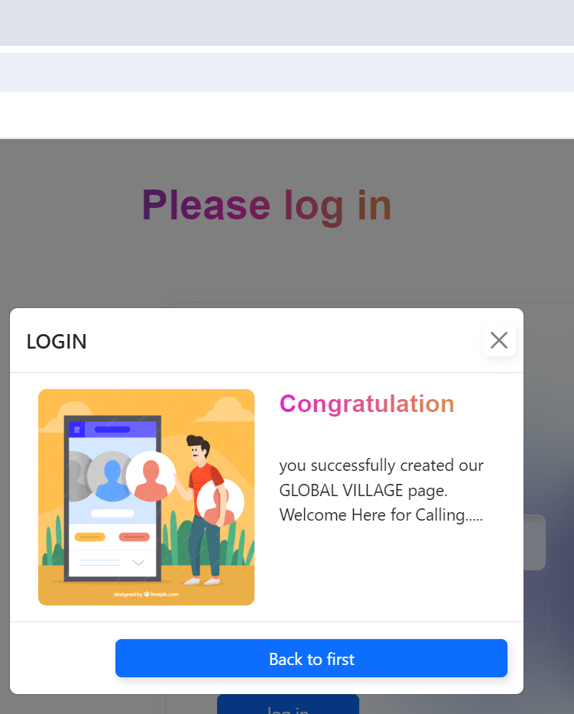
2.Log In Form
Only Sign in User can login by writing their user name and their password
They can even recover their password by clicking on forgot password.

Slide 22
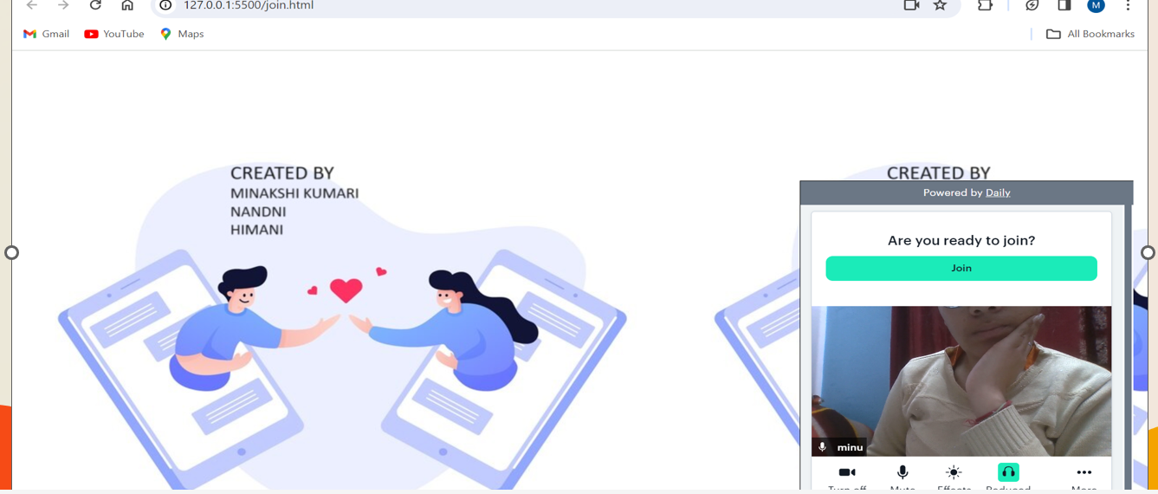
MAIN WINDOW WHERE MEETING JOIN

Slide 23
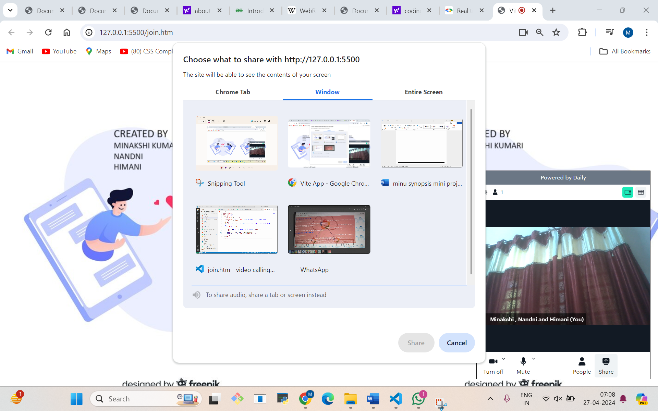
SCREEN SHARE WINDOW

Slide 24
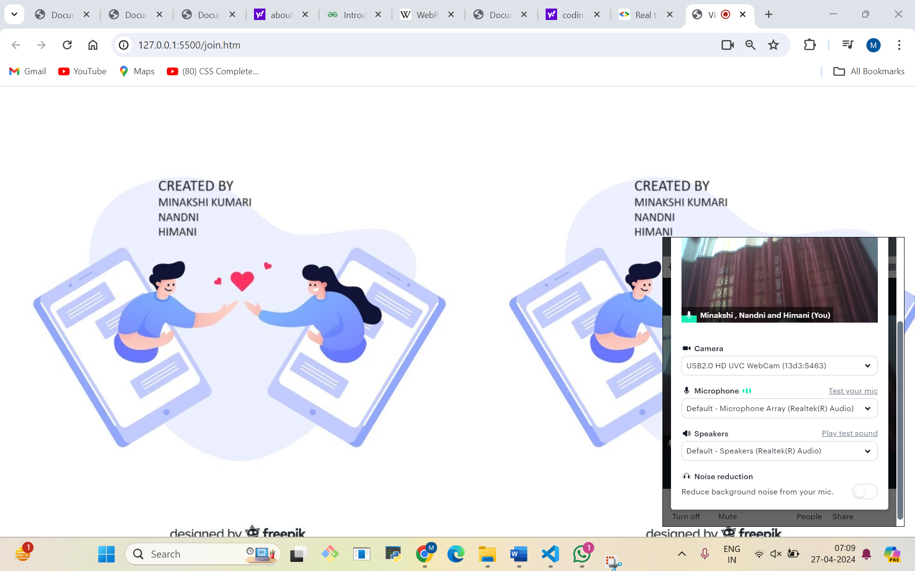
TESTING WINDOW

Slide 25
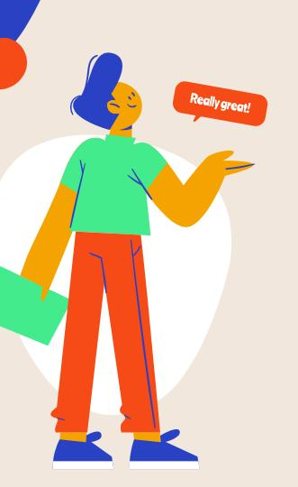
FUTURE SCOPE
Our future scope ?
In future scope of our Project we want to give the following points: -
Make exit option in our project.
Give video links for understanding the concepts of subjects links so it work as Educational platform for learning .
Also Provide some notes for various subjects.

Slide 26
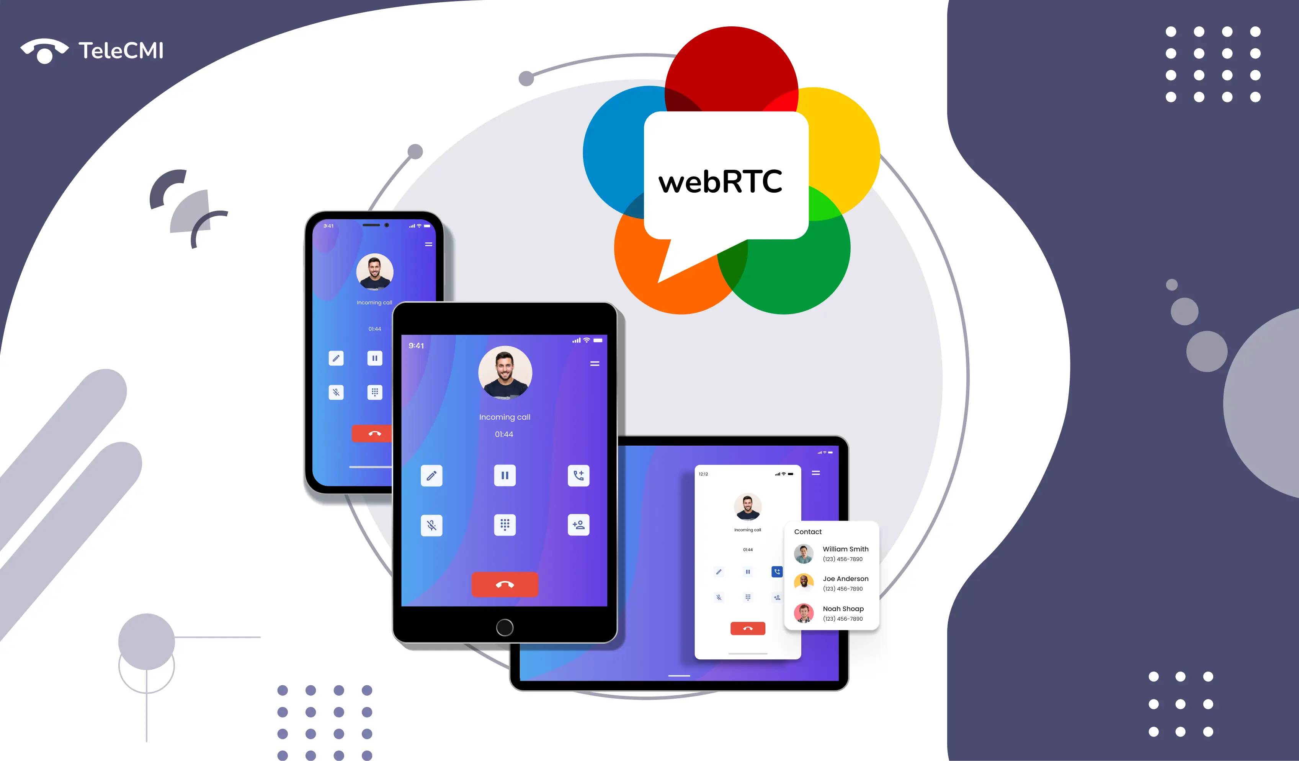
We enhance project and will generate live feedback which help organisation to understand customers demands as per requirements.
Give importance at various subjects in IT industry.

Slide 27
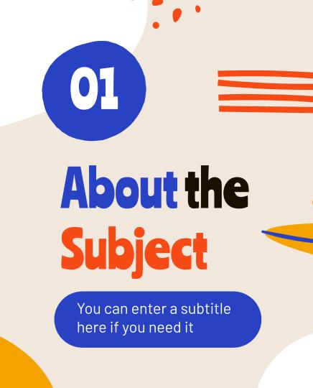
BIBLOGRAPHY
HELP TAKEN FROM !
For successfully completing my project file
I have taken help from the following website links:-
www.google.com
www.freepik.com
www.w3.school.com
https://medium.com/@fengliu_367/getting-started-with-webrtc-a-practical-guide-with-example-code-b0f60efdd0a7

Slide 28
Thanks!
Hi!

